Slide 1

AI-Assisted Learning Tool: Transforming Personalized Education
Our groundbreaking AI and voice-enabled interactive learning system delivers tailored educational experiences designed specifically for each user's unique background, learning style, and aspirations.
By creating dynamic, personalized learning pathways, we empower diverse users to access customized upskilling opportunities that continuously adapt and evolve with their individual progress and preferences.

Slide 2




Intake Form: Foundation for Personalization
Background Collection
Gathers educational history, degree information, and career details from each user.
Learning Style Analysis
AI identifies preferred learning methods, content types, and optimal pacing.
Goal Setting
Establishes clear objectives for knowledge acquisition and skill development.

Slide 3
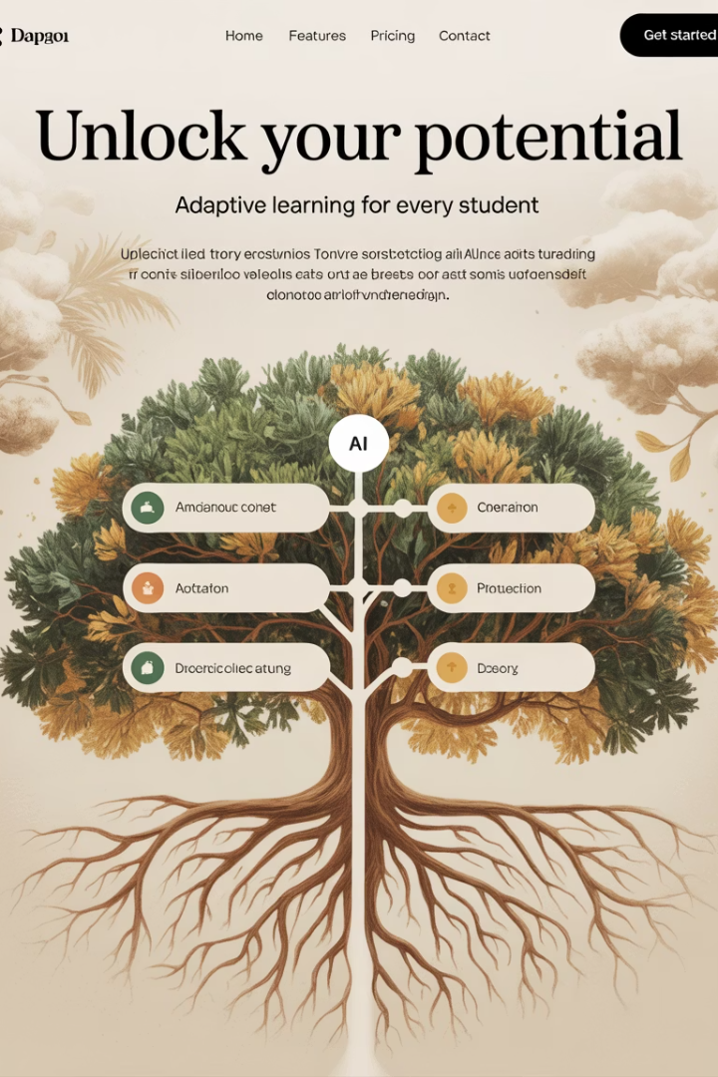



AI-Driven Customization: Adaptive Content & Experiences
Analyze User Data
System processes background information and learning patterns.
Tailor Content
Machine learning adjusts difficulty, pacing, and presentation style.
Holistic Approach
Covers academic, social, and emotional learning aspects.

Slide 4




Interactive, Voice-Enabled Engagement
Conversational Interface
Hands-free voice interactions create natural learning dialogues.
Real-time Feedback
AI provides immediate guidance on responses and questions.
Engaging Tools
Interactive quizzes, flashcards, and gamified lessons maintain interest.

Slide 5
Evaluation and Basic Problem Solving
Assessment
AI evaluates understanding through strategic questioning.
Guided Problem-Solving
Step-by-step modules break down complex concepts.
Targeted Remediation
System provides personalized help for knowledge gaps.
Mastery Confirmation
Verification ensures topics are fully understood.

Slide 6








Customized Curriculum Generation & Advanced Capabilities
Our system combines personalized curriculum creation with comprehensive monitoring tools.
Complete Learning Pathways
Fully integrated educational journeys
Dynamic Lesson Integration
Concepts, practice, and assessment combined
Automated Planning
Curriculum mapping for degrees and careers
Data Foundation
Intake and performance analytics dashboard
Our analytics dashboard tracks performance, engagement, and mastery metrics over time. Future predictive models will highlight growth areas and suggest personalized interventions, enabling data-driven adjustments to learning pathways.

Slide 7
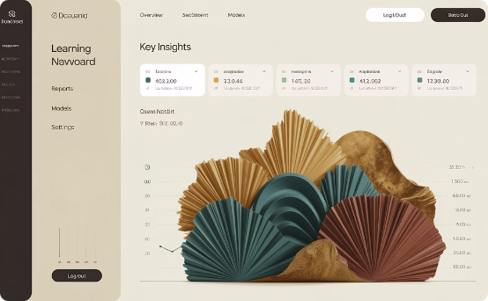
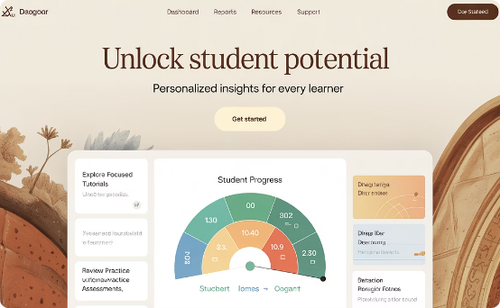

Future State:
Our comprehensive system will transform education through advanced analytics, personalized interventions, and adaptive learning technology.
Comprehensive Analytics Dashboard
Advanced Diagnostic Tools
Adaptive AI Engine
Precisely tracks learning outcomes, system engagement metrics, and mastery progression across all educational domains.
Identifies specific growth opportunities and generates tailored intervention strategies optimized for each learner's unique profile.
Generates customized learning content that builds upon established knowledge while introducing new concepts at optimal intervals.
Our machine learning capabilities will continuously refine instructional methodologies, optimizing knowledge retention and practical application of skills for every individual user.

Slide 8

Conclusion: Impact & Path Forward
Learner Benefits
System Advantages
Greater autonomy and truly personalized educational experiences. Higher engagement and improved outcomes.
Scalable education delivery at all levels. Efficient resource allocation based on individual needs.
Next Steps
Expanding content library. Refining customization algorithms.
Data monitoring and Data analysis.

